Slide 1
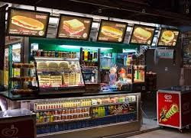
Bangalore Resto

Slide 2
A man has took a shop in rent near BTM layout, bangalore, not in the main road but as a local shop. The rent of the shop is 14000 per month. The man took the shop to sell fast food like - biryani, maggie, egg bhujia, omelets, chicken kabab etc.
In the first 3 months he make a profit of around 100000, with a sales of around 300000.
In the 1st month he was selling veg food also, but he stopped after the 2nd month as it stock was not getting out.
After 4 – 5 months down the line the man is making a huge loss in his investment. He has a due of 2 months to pay the rent.
The sale has drastically gone down and he is thinking to close the shop.
The man is very lazy in working hard and also very poor in any other investment.

Slide 3
Agenda
Introduction
Problem statement and data source
Objectives and methodology
Solution with description
Impact
Research

Slide 4
Introduction
In this era of digital world, most of the people are trying to switch their career in the hotel inn or restaurant.
Because, now a days most of people ordered the food through online platform like Zomato, swiggy etc.
One of the business man have started his own food stall at BTM layout which is situated in Bangalore state after lot of research for selling fast food like Maggie, Biryani, Egg Omelet etc. along with some veg food.
By the time, he was facing lots of difficulty in order to handle/maintain his business.
Now he has lost his business completely and he is searching for analyst so that he can comes through some insights that, why should he gone lost.

Slide 5
Problem statement and data source
By understanding causes of failure of food stall business, determine failure reasons ,failure criteria for the same so that it will results in increasing profit along with identifying needs of customers.
Data Source
Data is collected through Google form( online) and by Conduction of survey in local area.

Slide 6
Objectives
To analyze why sale goes down and suffered lost.
To analyze why customers were not came to stall for food by the time.
To understand what is need of customers who visited to shop
To understand what customers expected from him.
To analyze trends of customers.
To understand how to retain the customers.

Slide 7
Methodology
First analyze the chosen location
Understand the trend of customers and their financial status of them at chosen location
Conduct survey about competitors in that chosen area.
Do the self analysis and make changes accordingly.
Learn from past mistakes so that financial loss can never happened again

Slide 8
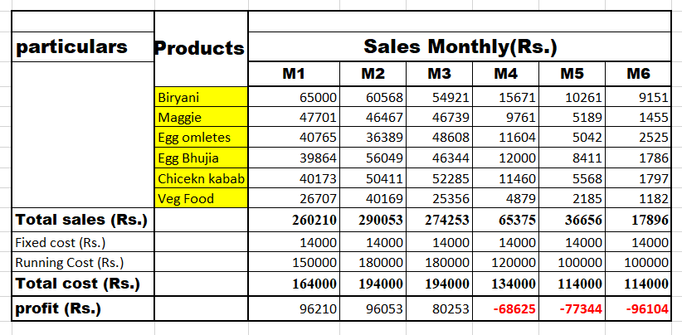

Slide 9
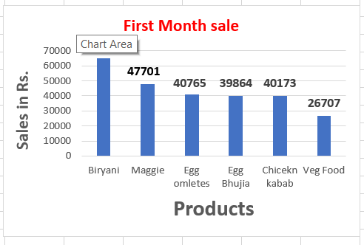
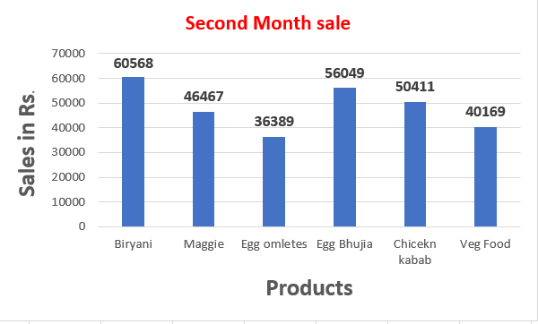
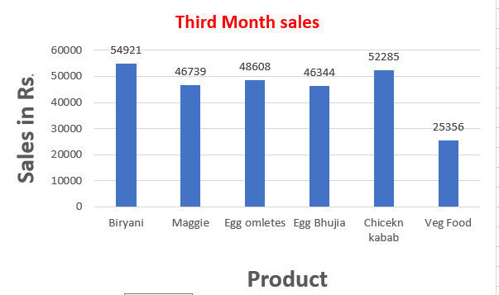
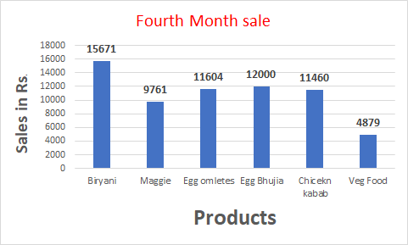
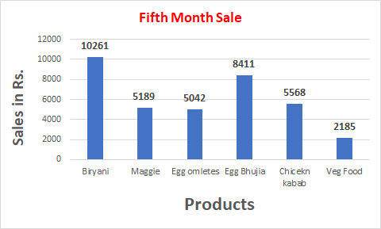
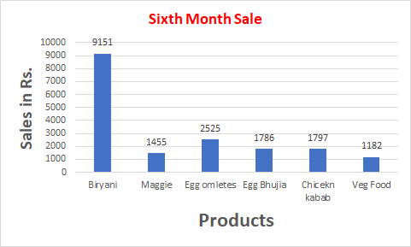

Slide 10
Descriptive solutions
Understand the needs of customers
Understood trend of customers
Conduct survey weather online or offline mode in region where you want to open food stall
Take survey of another food stall in that particular region and get the idea, understood the financial status of customers.
Try to give something different than others or implement some unique features in your business.
Try to retain customers by building repo with them.

Slide 11
Impact
He will understand trends and needs of customers
He will build repo with customers to retain them for longer time
He will give something extra than his competitors
He understand about the do’s and don'ts in his further business.

Slide 12
Research
BTM layout is Byrasandra, Tavarekere and Madivala layout which is situated in Bangalore state.
BTM layout is a very good location. It is near to companies like oracle, airtel, HSBC, Accenture, IBM, Honeywell, Motorola at 2 to 5 kms, IIM-B at 3 kms, BGS national school and Padma Sheshadri school at 2 to 3 km s, wockhard and apollo hospitals at 2 kms, shoppers stop at 4 kms and reliance mart at 1.5 kms.
It is well connected by trains, buses and public transports. Vegetable markets, shops, hotel, hospitals, banks, super markets are available in this locality.
Hence it is better place for starting Business but in order to maintain any business you should have some unique features for running the same.

Slide 13
Thank You

